Slide 1


Slide 2

HANDGUN RETENTION
Instructor:
Date:

Slide 3
Objective:
  To explain the Force Options Context of this module
  To examine the state of minds officers should be in
  To examine tactical thinking and its role in survival
  To examine the 3 steps to handgun retention and basic prevention
  To learn the basic methods of disarmament you may face
Method of Instruction:
Lecture-developmental and demonstrative performance
Training Aids:
Presentation, practical performance, written exam
Pen and paper are required

Slide 4
Introduction
Police Officers and Armed Guards are required to carry firearms as part of their equipment.
As such, they carry a much heavier burden in terms of personal safety.
A firearms changes the equation when dealing with situations as Officers now have a means of effectively and quickly delivering lethal force options.
However, if that option is taken from them and placed in the hands of a criminal, their safety as well as the safety of others is placed at risk.

Slide 5
Introduction
This module has been designed to give Officers an awareness of the firearm they carry, giving them training on how to keep a holstered firearm out of the hands of the criminal.
It is also designed to give Officers the ability to disarm a subject should their firearm be taken, or if another firearm is used against them.

Slide 6
Statistics
Almost 15,000 law enforcement officers have been killed in the line of duty.
Every year between 150 and 165 law enforcement officers are killed in the line of duty.
From 1986-1995, 197 convicts murdered a police officer while out on parole, probation, or early prison release.
More than 100 police killers during that period were under 18 years of age.

Slide 7
Statistics
Two police officers are shot every day in the United States.
Most officers are killed during arrest situations, disturbances and car crashes.
Most officers are killed between 4:01 P.M. and Midnight
20% of officers killed are killed with their own weapon.
90% of all subjects that disarm officers will attempt to use the firearm against the officer

Slide 8
Statistics
Most officers are killed within 60 seconds of contact with suspect. 40% of the time the officer is alone or has no backup available.
More than 189 police officers are assaulted every day in the U.S. (62,000 assaulted yearly) and rising (that is one out of every nine), with 21,000 injured. Many are permanently disabled.
The FBI reports that on yearly average: 380 officers are the targets of unprovoked attacks by ambush, resulting in 21 law enforcement deaths

Slide 9
Statistics
The most common reasons officers failed to retain their side arms were:
  The holster was left unsnapped
  There was lack of support/assistance/backup
  The officer was incapacitated at once and had no ability to resist
  The officer failed to react in a specific manner during the confrontation and failed to retain his weapon
  There was no training program of weapon retention offered against a variety of attacks or situations

Slide 10
Statistics
Three general situations were identified as commonly faced by officers:
  The weapon had been removed from the holster
  The attacker grabbed the barrel of the officers gun
  The attacker held the officers gun hand and attempted to wrench it from their grip

Slide 11
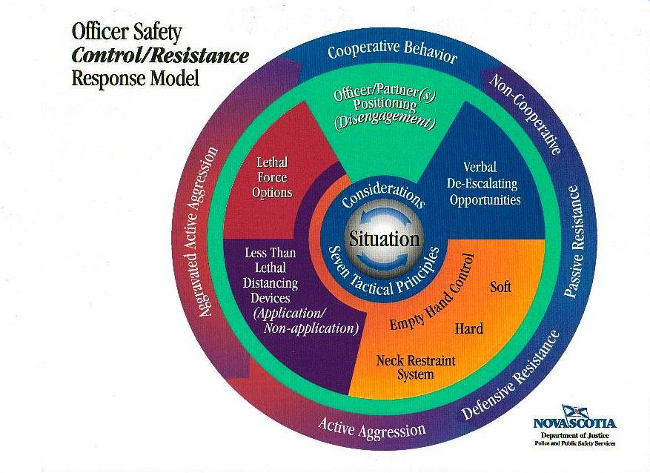

Slide 12
Force Level Option
Classified as Lethal Force Encounter
Used in relation to Aggravated Aggression

Slide 13
Force Level Option
If you lose your sidearm you must assume you will die by it.
Never surrender your sidearm to anyone.
Never give up.

Slide 14
States of Mind
Red
Orange
Yellow
White

Slide 15
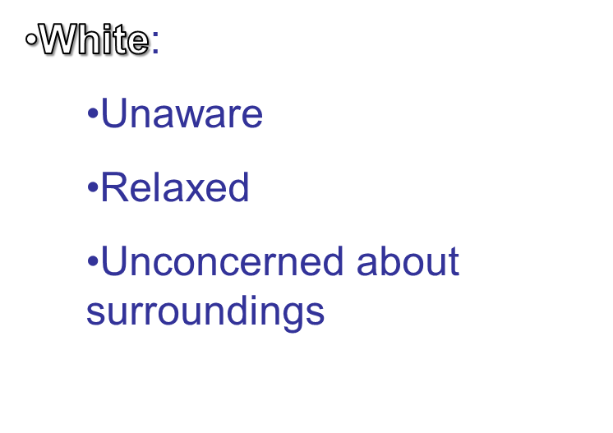
States of Mind
Red
Orange
Yellow
White

Slide 16
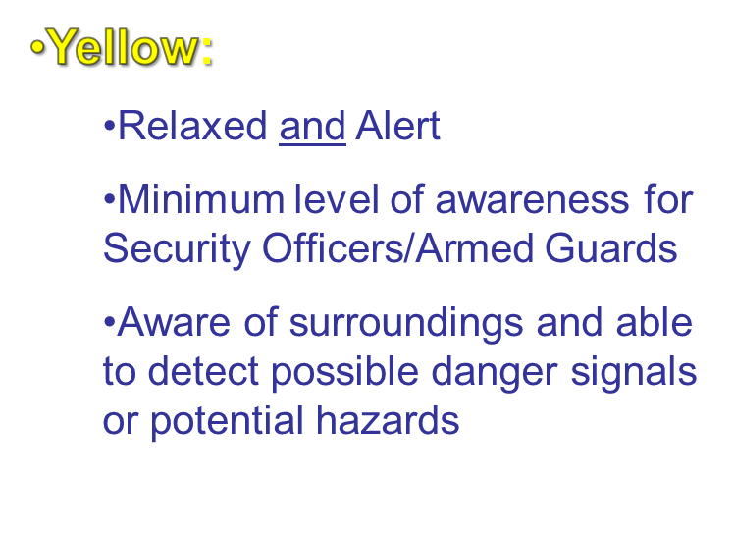
States of Mind
Red
Orange
Yellow
White

Slide 17
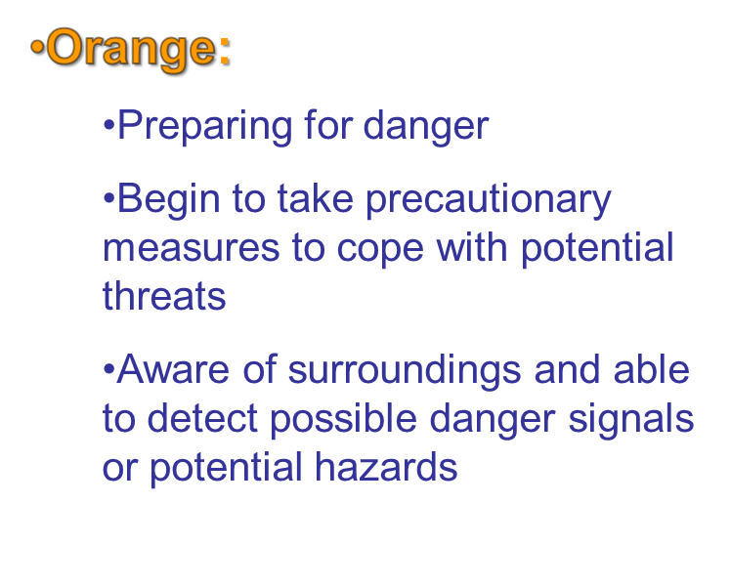
States of Mind
Red
Orange
Yellow
White

Slide 18
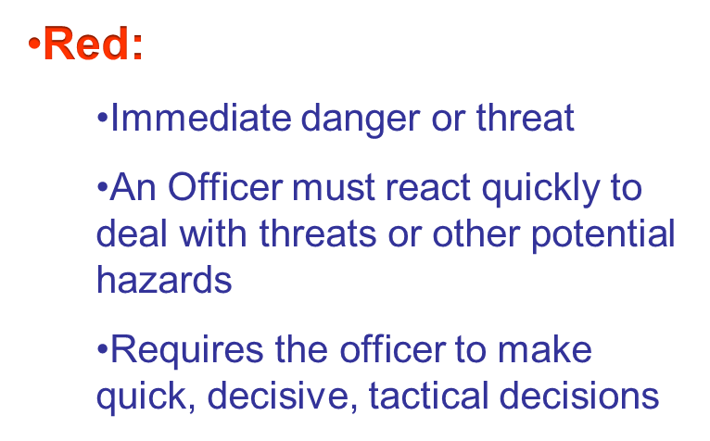
States of Mind
Red
Orange
Yellow
White

Slide 19
Tactical Thinking
Focus Point (Red)
Area of Responsibility (Orange)
Problem Area (Yellow)
White

Slide 20
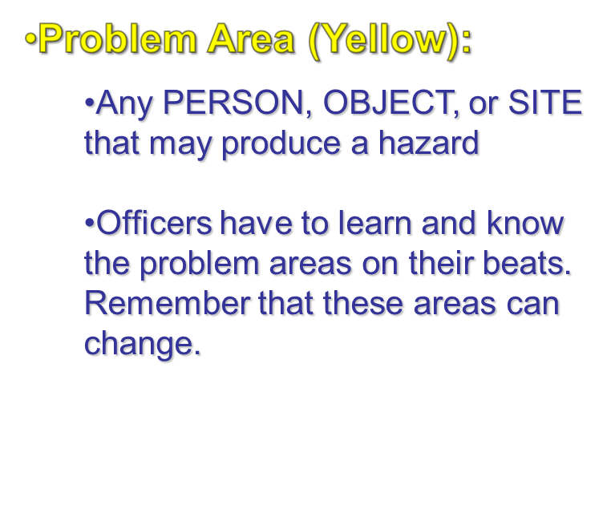
Tactical Thinking
Red
Orange
Yellow
White

Slide 21
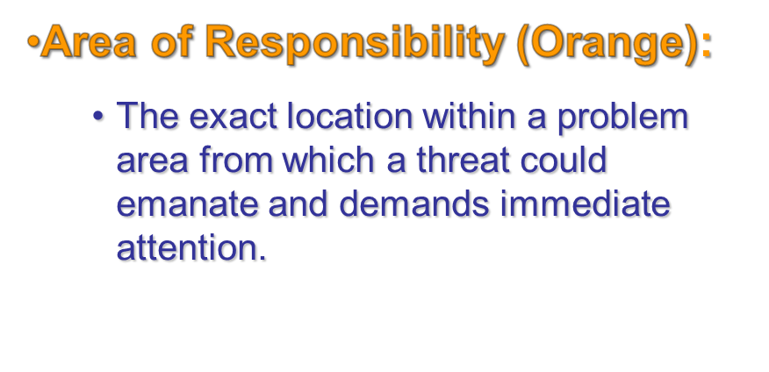
Tactical Thinking
Red
Orange
Yellow
White

Slide 22

Tactical Thinking
Red
Orange
Yellow
White
  Problem Area
  Suspect ten feet away
  Suspect three feet away
  Vehicle (occupied)
  House
  Area of Responsibility
  Hands
  Hands, feet, knees, head
  Doors, windows, trunk
  Windows, doors, roof, corners, hedges

Slide 23
Tactical Thinking
Red
Focus Point (Red):
  A clear and immediate perceived threat
  Must be controlled at once
  Not tunnel vision, but focusing in one threat at a time
Orange
Yellow
White

Slide 24
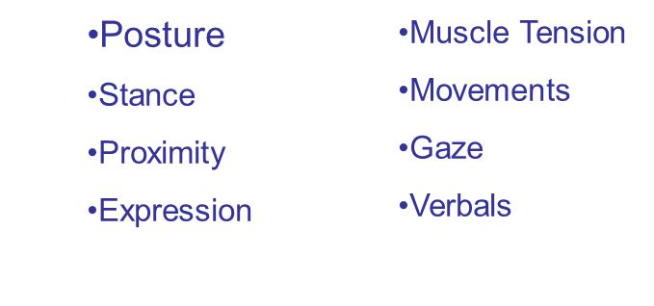
Tactical Thinking
Red
Why would someone want to invade your personal space?
  Intimidation
  Set up for an assault
Threat Cues/Precursors to attack
Orange
Yellow
White

Slide 25
Survival Strategies
Maintain a reactionary gap
Identify any threatening body language
Develop and practice a predetermined survival response
Maintain psychological control of the subject and environment

Slide 26
Seven (7) Tactical Principals
Verbalization
De-escalation
Threat Cues
Use of Cover
Time/Distance Ratio
1+1 Rule

Slide 27
Seven (7) Tactical Principals
Win Mentality
  That’s my gun, you’re just holding it for me!

Slide 28
Three Step System of Handgun Defense
Step One:
  Secure the Gun
    Maintain in the holster
    Security should be GUN oriented not person
    Both hands on holster or possibly subjects hands
    Press down into holster and your body
    Draw close to front center

Slide 29
Three Step System of Handgun Defense
Step Two:
  Position for Stability
    Same time as securing firearm
    Drop center of gravity
    Adopt a strong balanced stance
    Width and depth
    Usually 90˚ to subject
      Helps facilitate release
      Protects you
      Increases stability

Slide 30
Three Step System of Handgun Defense
Step Three:
  Remove threat / incapacitate subject
  Security of the sidearm is paramount
  Release tactics can include:
    Dysfunction of grabbing arm
    Stuns
    Pain compliance
    Incapacitating strikes

Slide 31
Holstered Gun Security Grips
There are two grips used to keep a gun in the holster during an assault
  Rear Gun Hand Grip
  Front Cross Grip

Slide 32
Prevention
Tactics
Physical Condition
Equipment
Deportment
Mentality

Slide 33
Role of The Holster
Provide retention for the firearm
Facilitate delivery of the firearm when needed
It is not part of the uniform…it is a critical piece of safety equipment
Approved duty holster have at least level 2 retention features
Allows officers to overcome reaction time

Slide 34
Common Officer Disarming Techniques
It is known that many career criminals have developed and practice methods of disarming Police Officers

Slide 35
Common Officer Disarming Techniques
Chop and Drop
  Grabs gun with both hands
  Drops to ground
  Officer has a tendency to pull away facilitating the disarming

Slide 36
Common Officer Disarming Techniques
Chop and Strip
  Chops down on security straps
  Grabs grip (inverted)
  Positioned to pull the trigger with the little finger

Slide 37
Common Officer Disarming Techniques
Rear Roll
  Approach from rear
  Defeat security snap
  Rolls gun forward from front break holster
  Draws back

Slide 38
Summary
You have learned:
  The Force Options Context of this module
  The states of minds officers should be in
  We have examined tactical thinking and its role in survival
  We have learned the 3 steps to handgun retention and basic prevention
  We have learned the basic methods of disarmament you may face

Slide 39
Take a Break and then lets go practice!

